Slide 1
Nuclear Decay Chains
Rob Sanchez
MTH305 F21

Slide 2
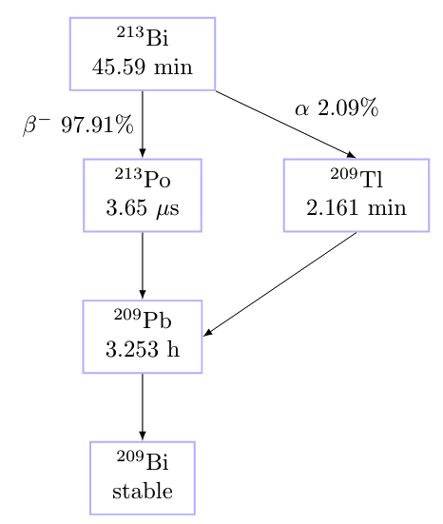
²¹³Bi decay chain
Used in cancer treatment (TRNT)
𝝉 = half-life (45.59 mins)
Time to decay for 50% of sample
Probability
Alpha & beta decay branches
Idea: Maintain counts in Bins (vectors)
2 models
Naïve Monte Carlo
Markov Chain
Question: What does the Final Distribution of Atoms Look like?

Slide 3
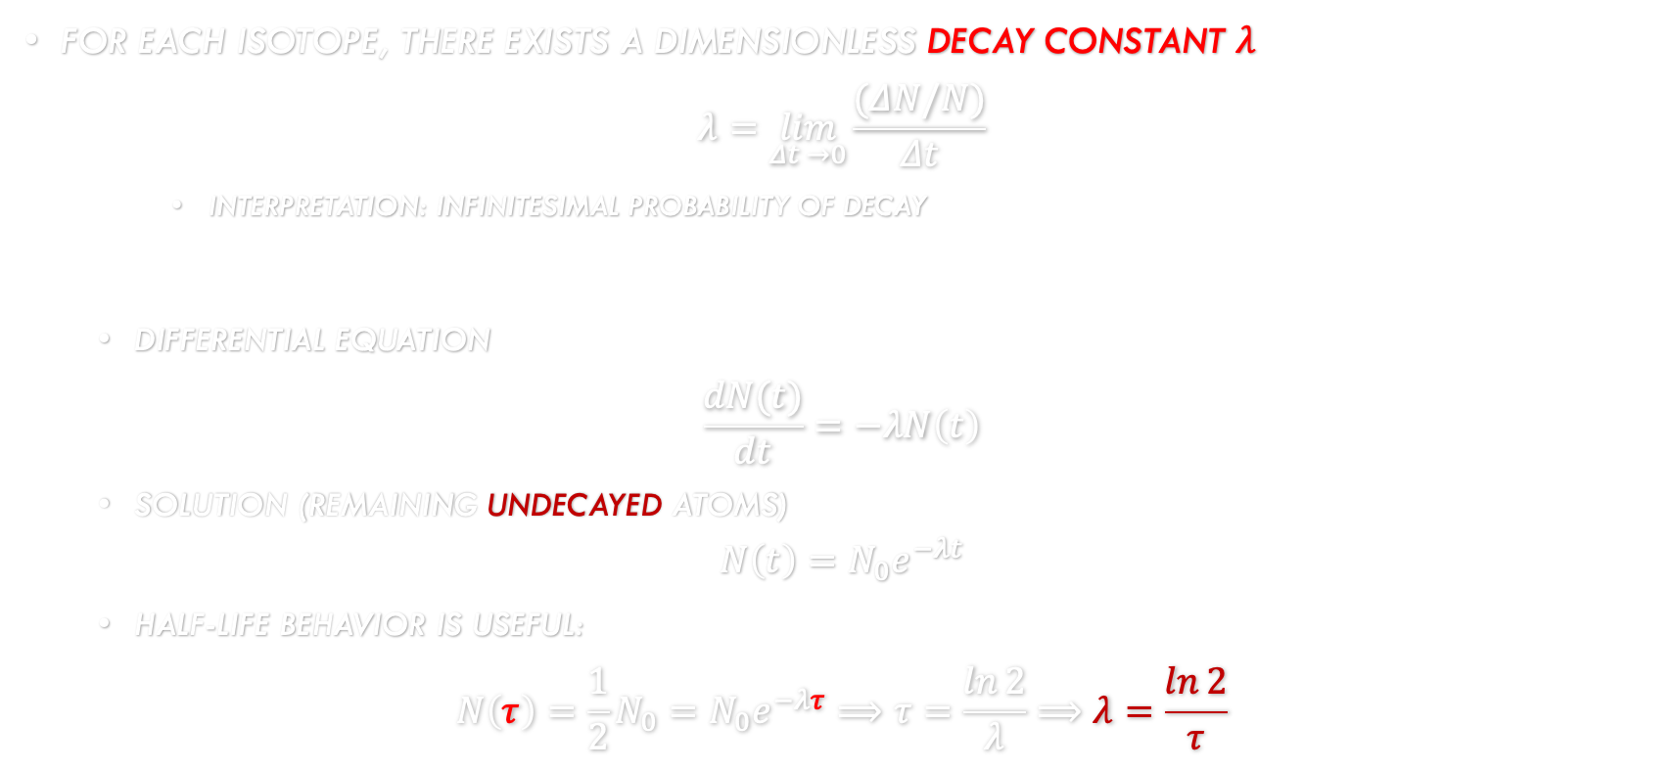
Background
For each Isotope, there exists a dimensionless Decay Constant $λ$
$$λ=\lim_{Δt →0}{\frac{(ΔN/N)}{Δt}}$$
Interpretation: Infinitesimal probability of Decay
Differential Equation
$$\frac{dN(t)}{dt}=−λN\left(t\right)$$
Solution (remaining undecayed atoms)
$$N\left(t\right)=N_{0}e^{−λt}$$
Half-Life behavior is Useful:
$$N\left(τ\right)=\frac{1}{2}N_{0}=N_{0}e^{−λτ}⟹τ=\frac{\ln{2}}{λ}⟹λ=\frac{\ln{2}}{τ}$$

Slide 4
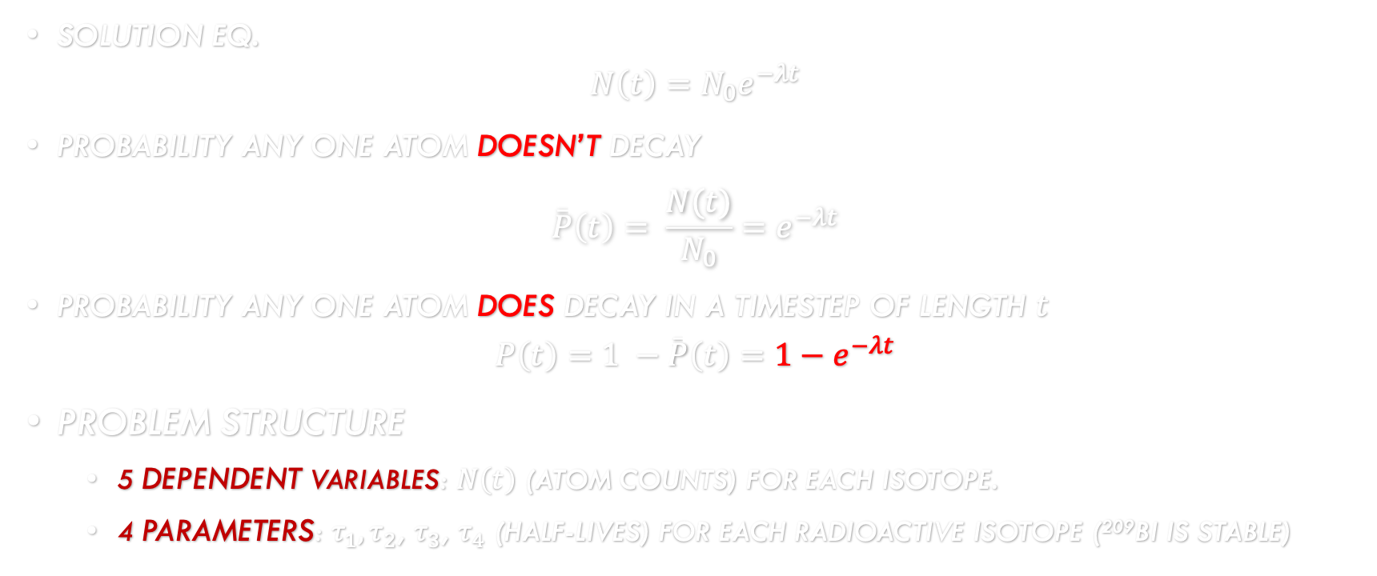
Probability & Problem Structure
Solution EQ.
$$N\left(t\right)=N_{0}e^{−λt}$$
Probability any one atom doesn’t decay
$$\overline{P}\left(t\right)= \frac{N(t)}{N_{0}}=e^{−λt}$$
Probability any one atom does decay in a timestep of length $t$
$$P\left(t\right)=1 −\overline{P}\left(t\right)=1−e^{−λt}$$
Problem Structure
5 dependent variables: $N\left(t\right)$ (atom counts) for each isotope.
4 parameters: $τ_{1},τ_{2}$, $τ_{3}$, $τ_{4}$ (half-liVeS) for each radioactive isotope (²⁰⁹Bi is stable)

Slide 5
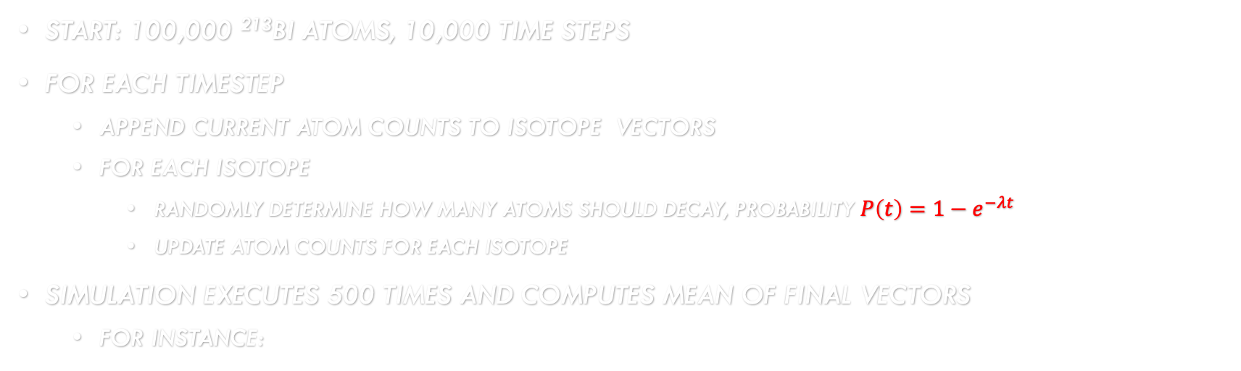
Naïve Monte Carlo
Start: 100,000 ²¹³Bi Atoms, 10,000 time steps
For each timestep
Append current Atom counts to Isotope Vectors
For Each ISOTOPE
Randomly determine how many Atoms should decay, probability $P\left(t\right)=1−e^{−λt}$
Update ATOM COUNTS FOR EACH ISOTOPE
Simulation executes 500 times and computes mean of Final Vectors
For instance:
Row │ Bi213 Po213 Tl209 Pb209 Bi209
│ Int64 Int64 Int64 Int64 Int64
─────┼───────────────────────────────────
1 │ 7710 1 10 62146 30133
2 │ 8032 1 9 62244 29714
3 │ 8009 1 6 61961 30023
4 │ 7990 1 4 61923 30082
5 │ 8138 6 12 61811 30033
[7976.0, 2.0, 8.0, 62017.0, 29997.0]

Slide 6
Markov Chain
# 5x5 markov chain transition matrix
# Bi213,Po213,Tl209,Pb209,Bi209
A = [ 1-dp4 0 0 0 0;
dp5 1-dp2 0 0 0;
dp6 0 1-dp3 0 0;
0 dp2 dp3 1-dp1 0;
0 0 0 dp1 1]
where dpX is a decay probability.
assumption: joint probabilities, independent events
computing A¹⁰⁰⁰⁰ * x0 is very fast

Slide 7
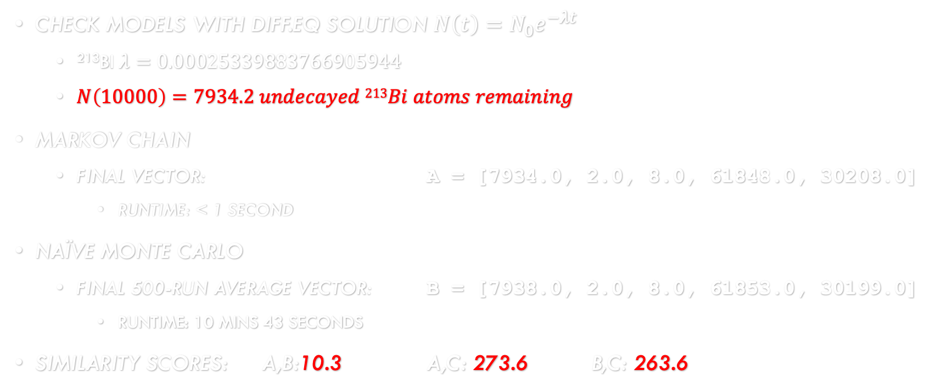
ACCURACY
Row │ Bi213 Po213 Tl209 Pb209 Bi209
│ Int64 Int64 Int64 Int64 Int64
─────┼───────────────────────────────────
1 │ 7710 1 10 62146 30133
2 │ 8032 1 9 62244 29714
3 │ 8009 1 6 61961 30023
4 │ 7990 1 4 61923 30082
5 │ 8138 6 12 61811 30033
C = [7976.0, 2.0, 8.0, 62017.0, 29997.0]
Check Models with Diff.EQ solution $N\left(t\right)=N_{0}e^{−λt}$
²¹³Bi$λ=0.00025339883766905944$
$N\left(10000\right)=7934.2 undecayed 213Bi atoms remaining$
Markov Chain
Final Vector: a = [7934.0, 2.0, 8.0, 61848.0, 30208.0]
Runtime: < 1 Second
Naïve Monte carlo
Final 500-run average vector: B = [7938.0, 2.0, 8.0, 61853.0, 30199.0]
Runtime: 10 mins 43 seconds
Similarity ScoreS: a,b:10.3 A,C: 273.6 B,C: 263.6

Slide 8
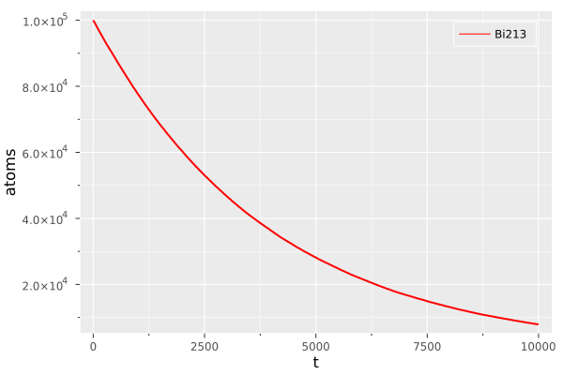
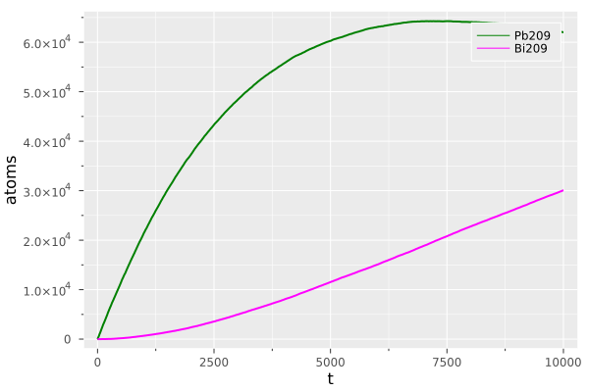
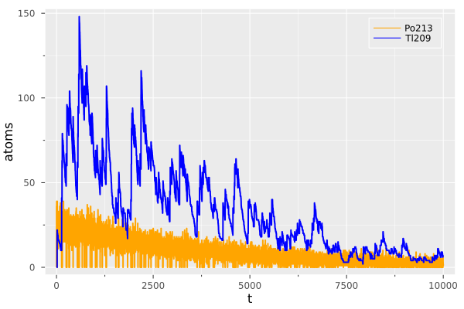
Isotope Plots (1)
Naïve Monte Carlo

Slide 9

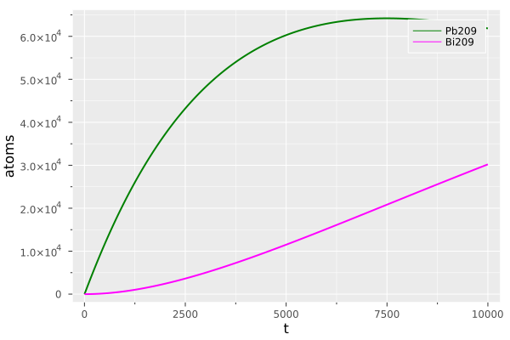
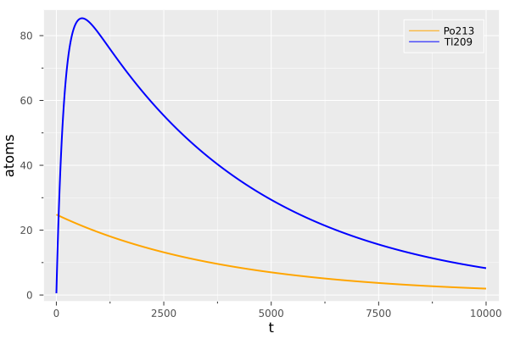
Isotope PLOTS (2)
Markov Chain

Slide 10
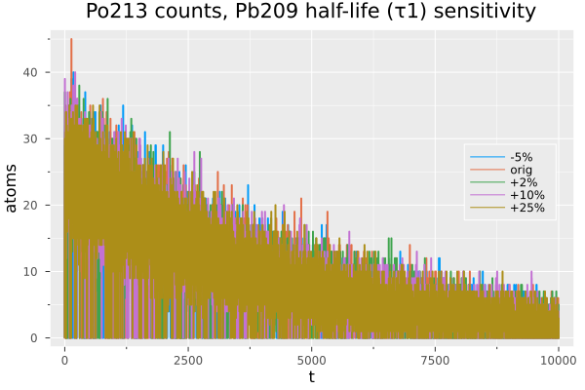
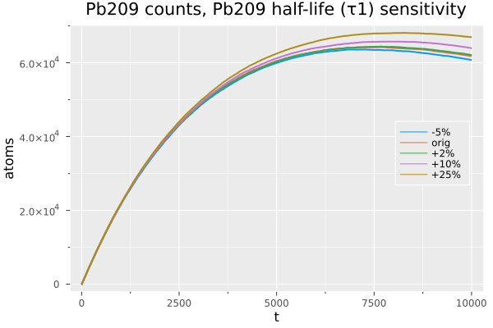
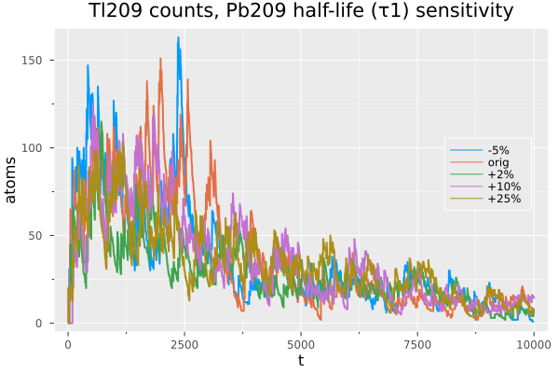
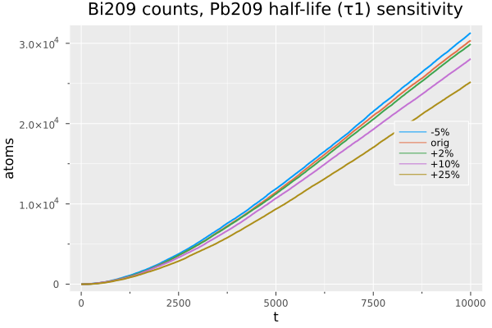

Model Sensitivity (1)
Naïve Monte Carlo
$τ1$, ²⁰⁹Pb half-life

Slide 11
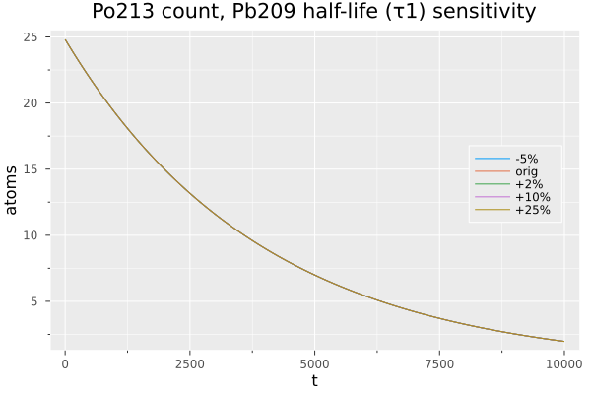
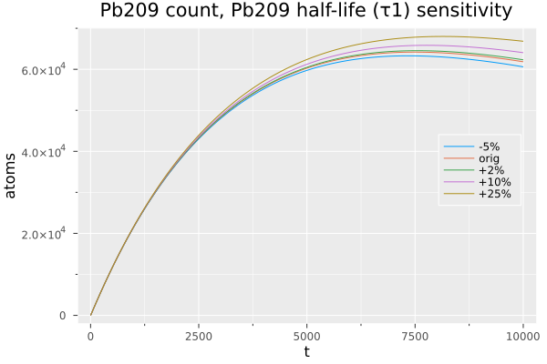
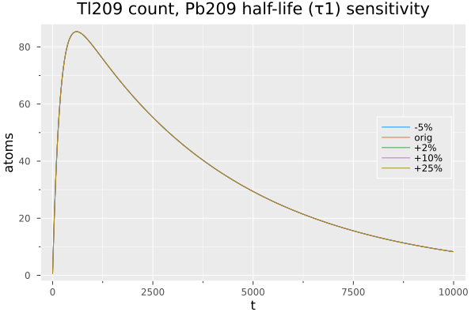
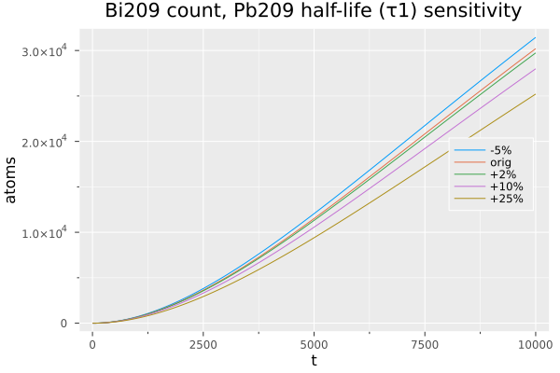

Model Sensitivity (2)
Markov Chain
$τ1$, ²⁰⁹Pb half-life

Slide 12
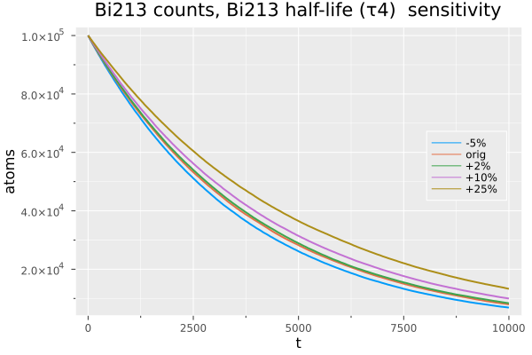
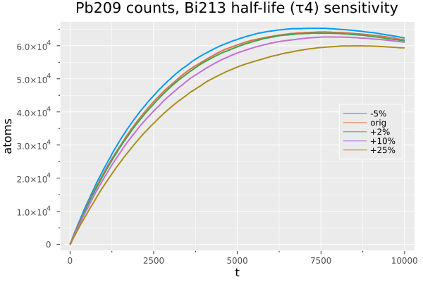
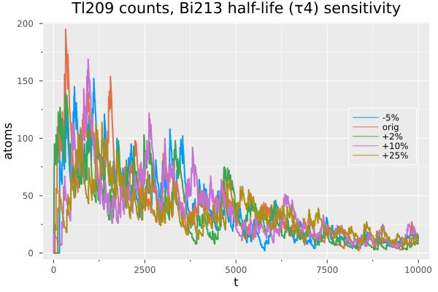
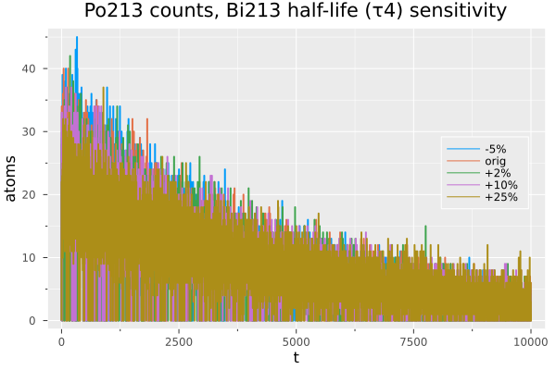
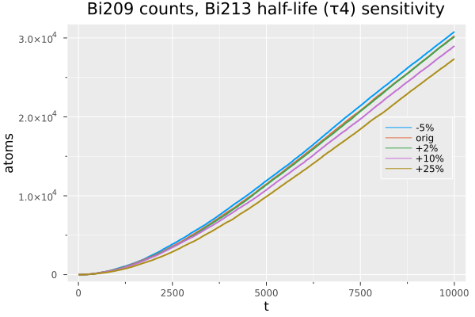

MODEL
SENSITIVITY
(3)
Naïve Monte Carlo
$τ4$, ²¹³Bi half-life

Slide 13
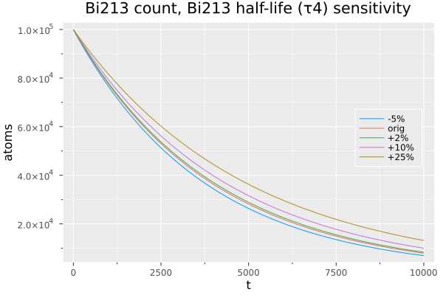
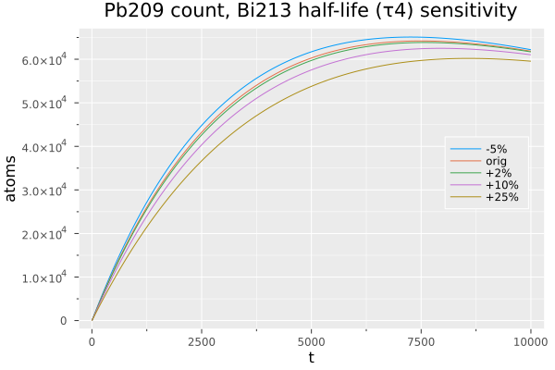
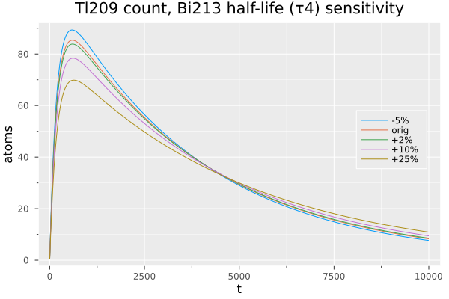
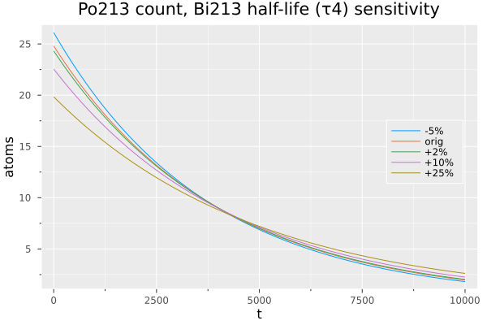
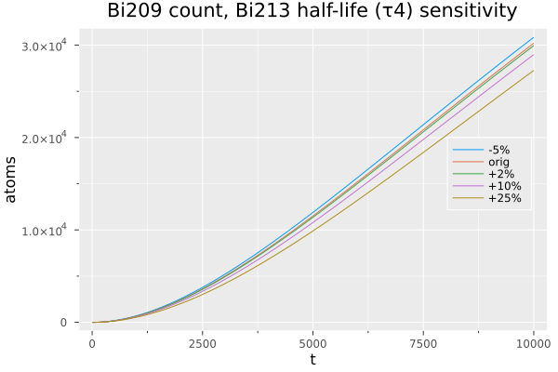

MODEL Sensitivity (4)
Markov Chain
$τ4$, ²¹³Bi half-life

Slide 14

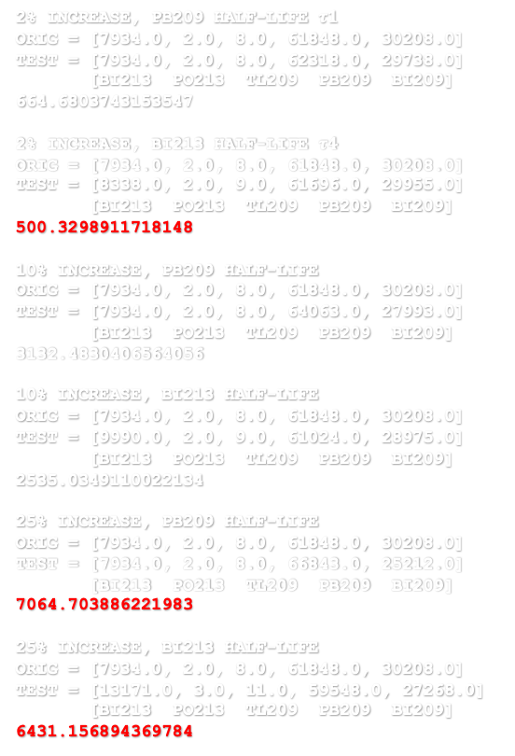

Model Sensitivity (5)
Naïve Monte Carlo
Markov Chain
2% increase, Pb209 half-life $τ1$
orig = [7982, 3, 8, 61904, 30103]
test = [8003, 1, 9, 62350, 29637]
[Bi213 Po213 Tl209 Pb209 Bi209]
645.3820573892646
2% increase, Bi213 half-life $τ4$
orig = [7932, 3, 9, 61645, 30411]
test = [8435, 3, 6, 61712, 29844]
[Bi213 Po213 Tl209 Pb209 Bi209]
760.9178667898395
10% increase, Pb209 half-life
orig = [7865, 3, 3, 61963, 30166]
test = [8073, 0, 10, 63927, 27990]
[Bi213 Po213 Tl209 Pb209 Bi209]
2938.6381199460407
10% increase, Bi213 half-life
orig = [7990, 0, 3, 61496, 30511]
test = [9918, 1, 9, 61091, 28981]
[Bi213 Po213 Tl209 Pb209 Bi209]
2494.4229793681743
25% increase, Pb209 half-life
orig = [7878, 1, 20, 61856, 30245]
test = [8088, 2, 6, 66903, 25001]
[Bi213 Po213 Tl209 Pb209 Bi209]
7281.2115750059065
25% increase, Bi213 half-life
orig = [7865, 3, 5, 62018, 30109]
test = [13292, 4, 12, 59693, 26999]
[Bi213 Po213 Tl209 Pb209 Bi209]
6673.08804077992
2% increase, Pb209 half-life $τ1$
orig = [7934.0, 2.0, 8.0, 61848.0, 30208.0]
test = [7934.0, 2.0, 8.0, 62318.0, 29738.0]
[Bi213 Po213 Tl209 Pb209 Bi209]
664.6803743153547
2% increase, Bi213 half-life $τ4$
orig = [7934.0, 2.0, 8.0, 61848.0, 30208.0]
test = [8338.0, 2.0, 9.0, 61696.0, 29955.0]
[Bi213 Po213 Tl209 Pb209 Bi209]
500.3298911718148
10% increase, Pb209 half-life
orig = [7934.0, 2.0, 8.0, 61848.0, 30208.0]
test = [7934.0, 2.0, 8.0, 64063.0, 27993.0]
[Bi213 Po213 Tl209 Pb209 Bi209]
3132.4830406564056
10% increase, Bi213 half-life
orig = [7934.0, 2.0, 8.0, 61848.0, 30208.0]
test = [9990.0, 2.0, 9.0, 61024.0, 28975.0]
[Bi213 Po213 Tl209 Pb209 Bi209]
2535.0349110022134
25% increase, Pb209 half-life
orig = [7934.0, 2.0, 8.0, 61848.0, 30208.0]
test = [7934.0, 2.0, 8.0, 66843.0, 25212.0]
[Bi213 Po213 Tl209 Pb209 Bi209]
7064.703886221983
25% increase, Bi213 half-life
orig = [7934.0, 2.0, 8.0, 61848.0, 30208.0]
test = [13171.0, 3.0, 11.0, 59548.0, 27268.0]
[Bi213 Po213 Tl209 Pb209 Bi209]
6431.156894369784
Modifying $τ_{1} \&{ τ}_{4}$
VECTOR SIMILARITY
Measure by computing L2 or Euclidean norm of the difference between the vectors, $\left\|𝕩\right\|=\sqrt{x_{1}^{2}+x_{2}^{2}+ …+x_{n}^{2}}$
Scalar value, the smaller the more similar the vectors (aka distance/magnitude)
$$\left\|orig −test\right\|=norm(orig−test)$$
numpy.linalg.norm()
LinearAlgebra.norm()

Slide 15

Future Notions
Larger Decay chains, e.g. for ²³²Th, ²³⁵U, and ²³⁸U (nuclear fuels)
Analyze difference between $λ$ and $P\left(1\right)$ for more isotopes
Increase/decrease time step width
Find Strategy for checking $N\left(t\right)$ for other isotopes
Start execution runs with >0 atoms in each bin

